Slide 1
IET BRIDGE
Connecting our alumni, fostering community, and empowering success.
1.Komal Pathare(250245920041)
2.Ghanshyam Patil(250245920029)
3.Rohini Natve(250245920073)
4.Suyash Gaikwad(250245920088)
5.Satyam Nema(250245920077)

Slide 2
INTRODUCTION TO IET BRIDGE
The IET BRIDGE is a platform that helps institutes stay connected with their former students (alumni). Alumni can register, update their profile, join events, share job openings, and talk to other alumni.
Admins can manage alumni data, post news or events, and keep track of activity on the platform. It makes communication and networking easier between alumni and the institute.

Slide 3


Core Modules Overview
Our platform is built around key modules designed to enhance alumni engagement and connectivity.
Registration & Profiles
Seamless onboarding and comprehensive profile management.
Directory & Search
Effortless discovery of alumni based on various criteria.
Events & Jobs
Dynamic event management and a dedicated job board.
Communication & News
Robust messaging and timely updates for the community.

Slide 4

PROBLEM DEFINATION
Most educational institutions struggle to maintain contact with their former students. There is no proper system to store alumni data, organize events, share job opportunities, or communicate effectively. As a result, valuable connections and networking opportunities are lost.
The lack of a centralized platform makes it difficult to:
∙
Track alumni details and career progress
∙
Organize reunions, webinars, or meets
∙
Share news, announcements, or success stories
∙
Offer job/internship opportunities to students and alumni
∙
Communicate between alumni and the institute
To solve these problems, an IET BRIDGE is needed to connect alumni with each other and with the institute in a structured and effective way.

Slide 5
System Requirements
Meeting these requirements ensures a reliable, secure, and efficient system for all law enforcement personnel.
Hardware Needs
Operating System (OS): Windows/Linux
Storage: A 512GB SSD (Solid State Drive) is the minimum for fast boot times and application loading; A minimum of 8GB RAM is essential
Software Specifications
1.Use React 18.x
2. Microsoft SQL Server (Database) 2022
.NET (Backend) initial deployment might require at least 4-8GB RAM for a small to medium database can be deployed on AWS EC2 Database Server: Can be on the same machine for small-scale; consider dedicated DB instance for higher load.3

Slide 6
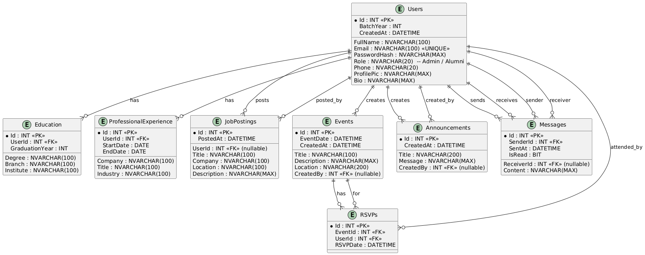
ER DIAGRAM

Slide 7
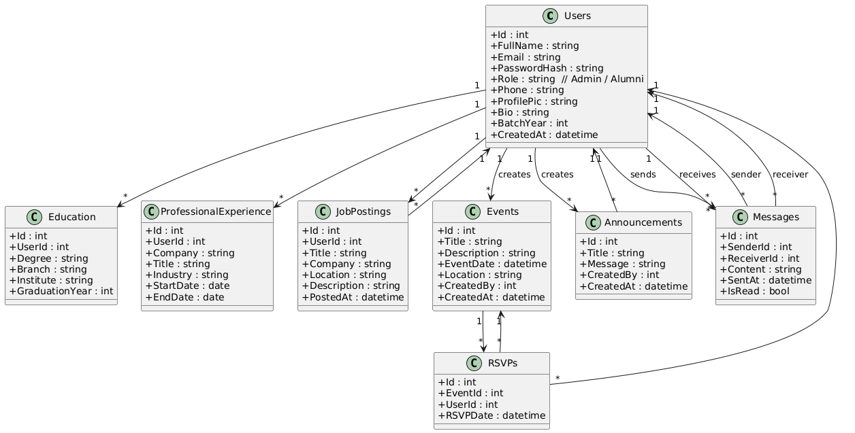
CLASS DIAGRAM

Slide 8
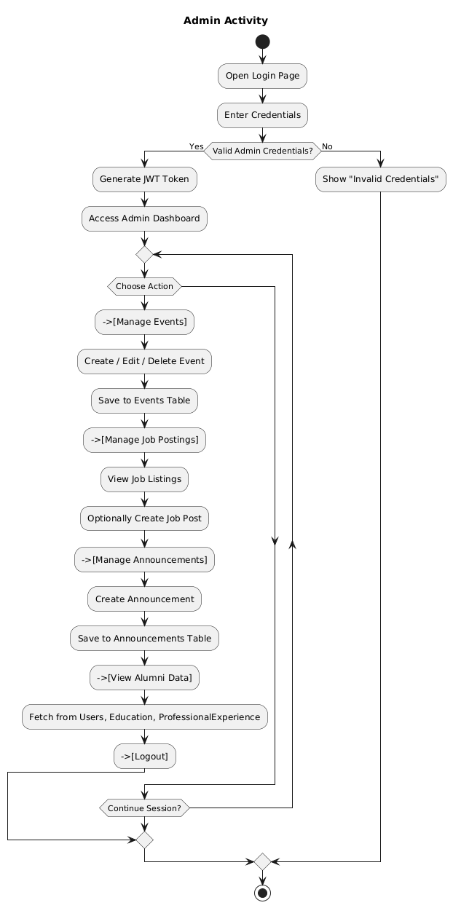
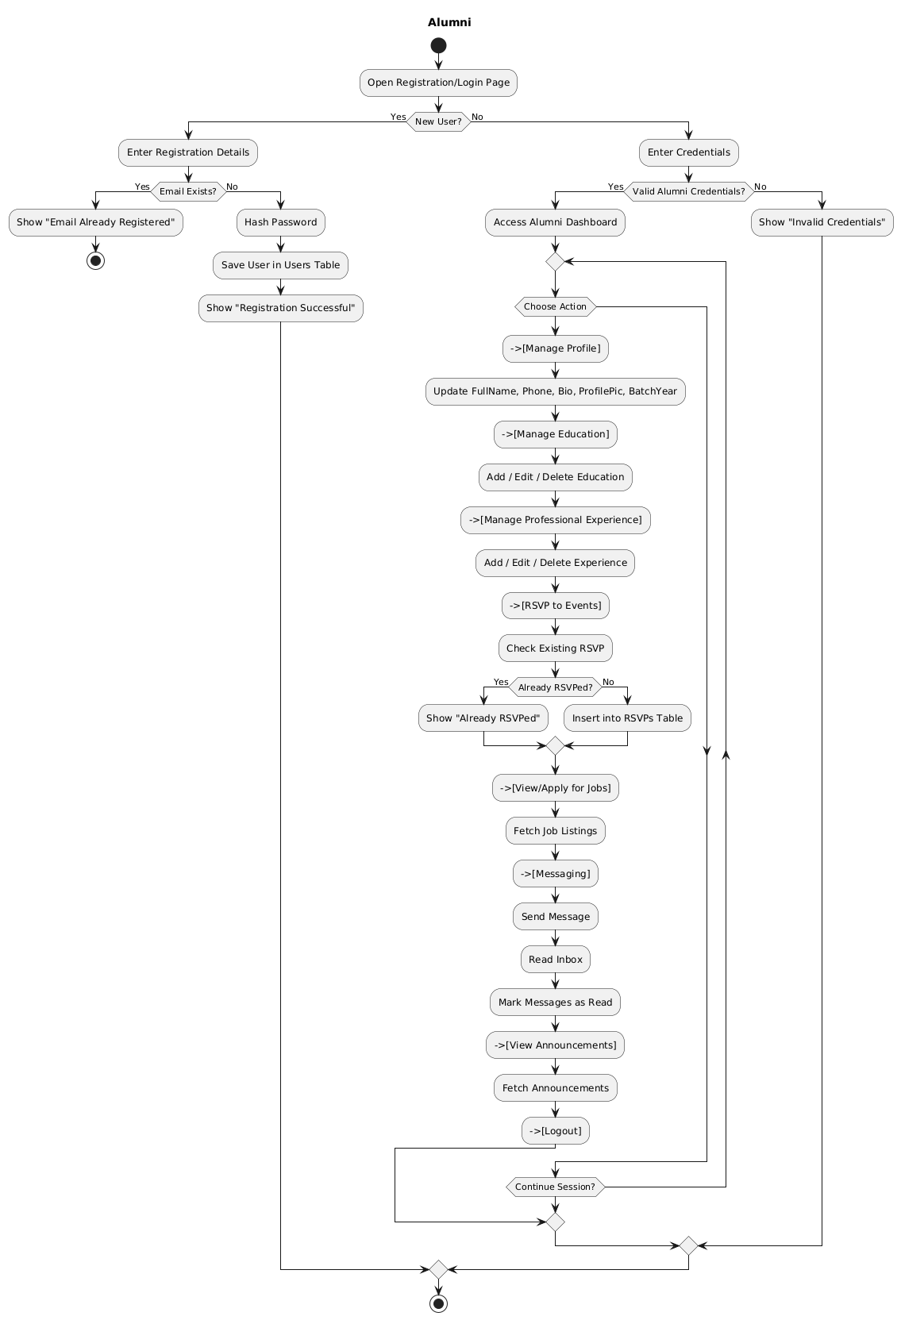
ACTIVITY DIAGRAM :

Slide 9
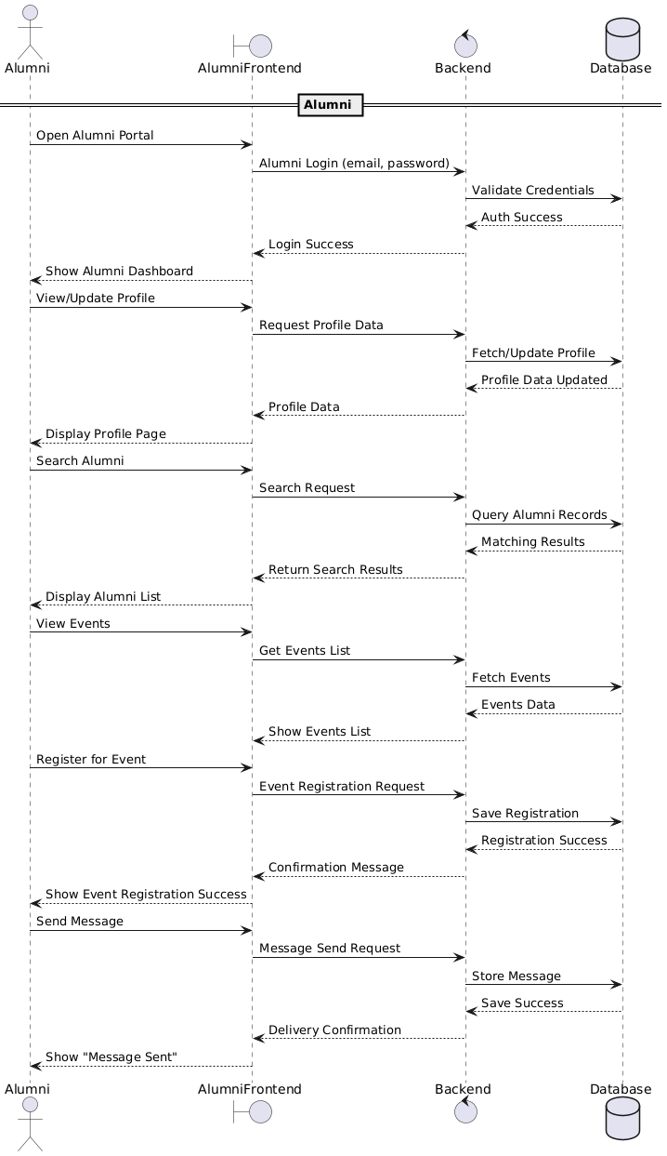
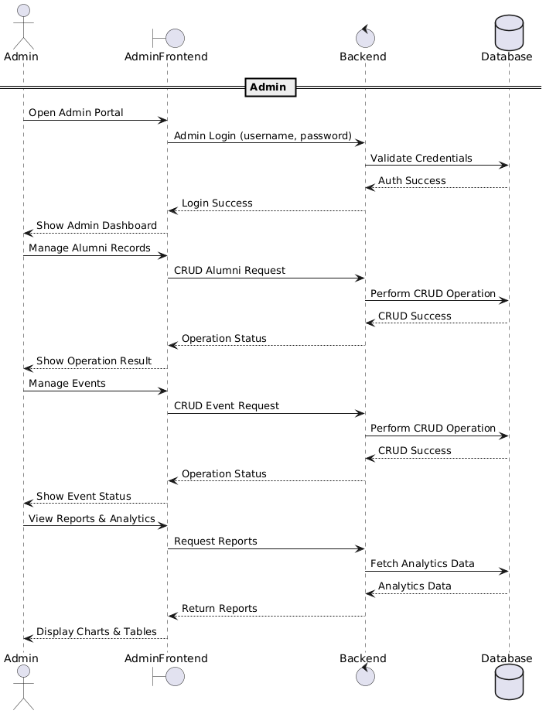
SEQUENCE DIAGRAM:

Slide 10
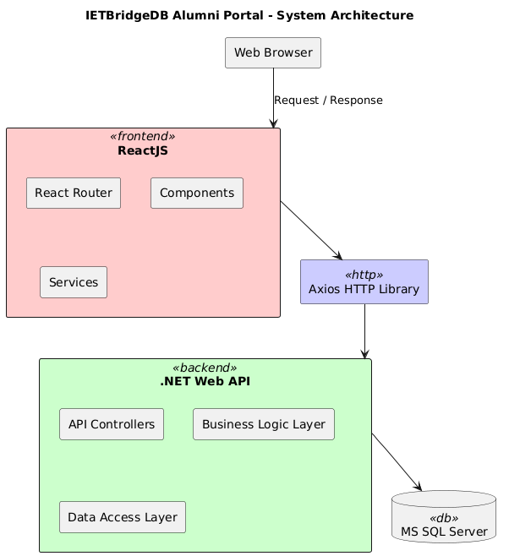
System Architecture

Slide 11
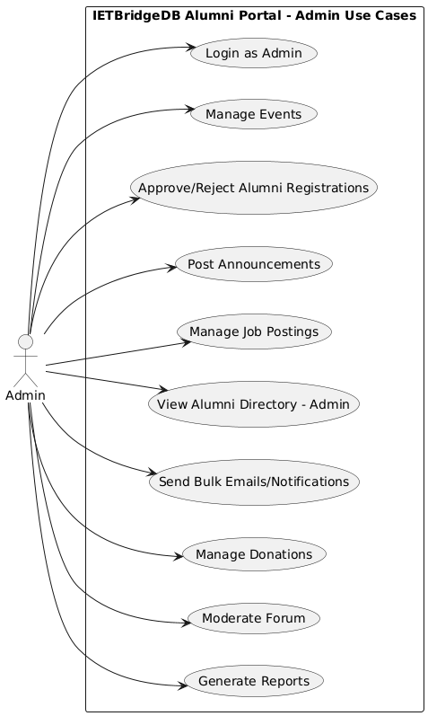
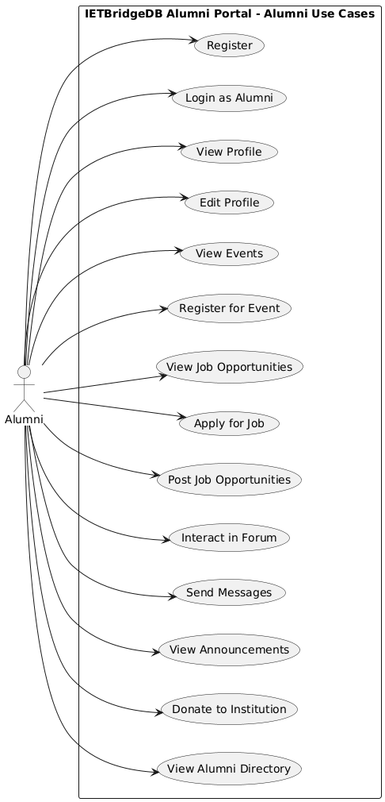
USE CASE DIAGRAM

Slide 12

Thank You!
We appreciate your interest in IET BRIDGE. Our platform is designed to strengthen connections within our alumni community and with the institute.
We look forward to building a thriving network together.

